Slide 1

Overview of Under Armour
By Anthony Berry and Anthony Szol

Slide 2
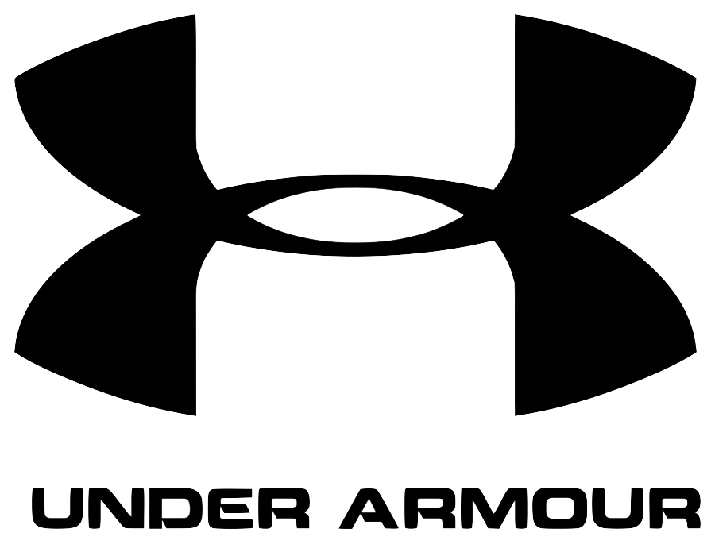
Company overview
Founded by Kevin Plank in 1996
Sportswear Industry
Footwear, performance apparel, and accessories
Notes:
Kevin Plank founded Under Armour in 1996 when none of his t-shirts would keep him dry with playing football at the University of Maryland. He was CEO from 1996 until 2020, when he began his role as Executive Char and Brand Chief. Under Armour is a company in the sportswear industry with the primary focus on footwear, performance apparel, and accessories such as armbands and cases for your phone or music player for active men, women, and youth.

Slide 3
Geographic segments
Under Armour, Inc.
North America
EMEA
Asia Pacific
Latin America
Notes:
Their business operate in four geographic segments, North America, comprising of the United States and Canada; Europe, the Middle East and Africa or EMEA, Asia-Pacific, and Latin America. In fiscal 2023, North America represented 65% of net revenue.

Slide 4
Organizational Structure
Kevin Plank
Executive Chairman
Brand Chief
David Baxter
President of the Americas
Dave Bergman
Chief Financial Officer
Shawn Curran
Chief Supply Chain Officer
Jim Dausch
Chief Consumer Officer
Tchernavia Rocker
Chief People
Administrative Officer
Mehri Shadman
Chief Legal Officer
Corporate Secretary
Notes:
Here we have Under Armour's executive officers and their titles. These officers have an important role in the operation of under armour. Each have individualized focuses on areas such as information technology, marketing, product development, mobile app development, sales, finances, and human resources.

Slide 5
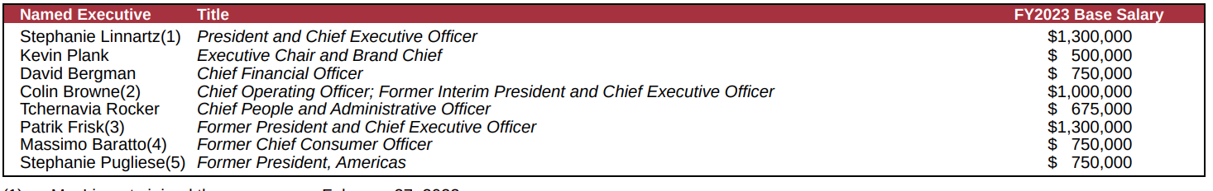
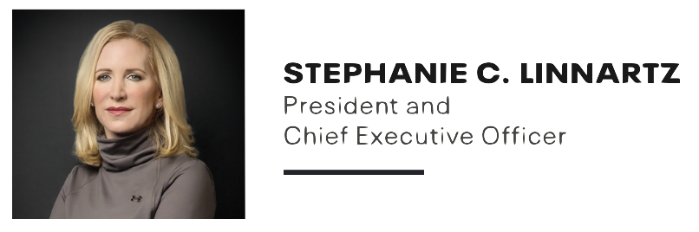
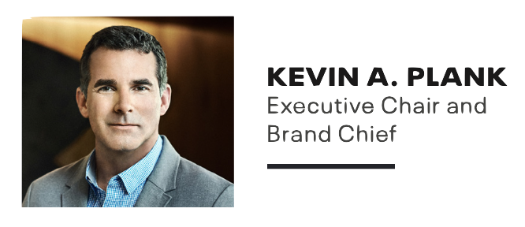
Executive leadership team
Notes:
Below is the executive leadership team and their base salary from fiscal year 2023. Stephanie Linnartz began her career at Under Armour in January 2023, before that, she was President for Marriot and a Board or Director member for the Home Depot. As mentioned before, Kevin Plank is the founder and step down as president in 2020.

Slide 6
Position in Marketplace
Professional Sports
Steph Curry Partnership
NCAA & XFL Sponsorship
Key Competitors: Nike, Adidas, New Balance
Notes:
Professional sports plays the most crucial role in the performance sportswear marketplace. Companies like Under Armour build partnerships with athletes, teams, and leagues to boost their sales. Think about it this way, if you watch your favorite athlete or team use a Under Amrour branded sportswear, you’re more likely to it. Why? Because your role models trust the brand.
Under Armour recently created a partnership with Steph Curry. This deal will be a huge impact on sales. Like I said earlier, peope want to buy brands that their favorite players trust. Curry has made a huge impact in the gam of basketball since he entered the league. He is admired by many and this could help increased sales.
Under Amour have partnerships with other top tier athletes such as Jordan Spieth, Michael Phelps, and Bryce Harper. But what we want to focus more on is the teams and leagues that Under Armour sponsor. Under Armour has a huge presence in the NCAA and XFL. Unfortunately, in comparison to their competitors, Under Armour's sponsorships are weak.
Currently, Nike, Adidas, and New Balance are Under Armour’s key competitors. All these companies specialize in performance sportswear and have their own presence in professional sports. For example, Nike has a huge presence in the MLB and supplies all team uniforms while Adidas has a huge presence in the FIFA.

Slide 7
SWOT Analysis
Strength | Weakness
High quality of apparel products Innovative and involved in technology Celebrity athlete partnership and trust Four geographical segments | Social Media Presence International presence Heavily dependent on performance apparel High days in inventory Poor Marketing
Opportunities | Threats
International performance apparel Ecommerce Footwear products | Nike and Adidas R&D Brand awareness Operating cost
Notes:
Here we have our SWOT analysis of Under Armour.
Lets start with Strength
At some point, you have probably worn or touched an apparel product from Under Amour. They offer high quality materials that will not only make people want to buy the product, but continue to purchase. With their technology accessories and involvement in the MyFitness Pal app, Under armour displays a stength in innovation in technology. As mentioned previously, Under Armour has great celebrities and athletes to endorse their products. Huge for sales. Lastly, their four geographical segments provide and strong distribution network across the globe
Weakness
Compared to other companies, UA lacks the social media trend. For example, UA is known for their compression shirts and leggings. Well, companies like lululemon are making a huge impact on social media. Next is international presence, while this is may sound contidictive to their geographical stength, as a reminder, the North America was 65% of their sales in 2023. That means only 35% of revenue was from the other three segments. Increasing their international presence will not only even out the margin, but increase their annual revenue. Under armour is heavily dependent on their performance apparel items. In 2023, _____ percent of revenue came from performance apparel. If you've heard the term, don't put all your eggs in one basket, then you know this can hurt under armours annual revenue. In 2019, UA's days in inventory increased by 11% to $1.3B. They need to lower this number to stay competitive.
Opportunities
Under Armour focuses on performance apparel revenue. The company has an opportunity to leverage this strength to gain international presence. Now-a-days, ecommerce has been growing these past few years. Ecommerce is a great opportunity for grow for the company. In fact, Under Armour's ecommerce 3% in 2023 compared to 2022. The last opportunity is footwear. As mentioned before, UA produces high quality items but their footwear designs have not met the standards as their competitors. To become less dependent on performance apparel sales, UA can invest in footwear productions.
Threats
One that note, the first threat is Nike and Adidas' R&D. These competitors are constantly growing and improving their product's technology. If UA doesn't do the same, they will become obsolete. Next is lack of brand awareness. There are tons of performance apparel brands out there now-a-days. The company needs to increase their brand awareness internationally, social media, and the athletic stage. Last is operating cost. Raw materials and services are continuing to raise. If the company does not increase sales performance, they will see a decline in net profits.

Slide 8
Key Risks & Trend
Risks | Trends
Diluted brand awareness Increased cost of labor and materials The rise of obesity in the US Recession Fall of brick and mortars | Ecommerce Growth of performance apparel Remote working Quality over cost Football season
Notes:
Now we have to look at the key risks and trends under armour faces. Lets start with the risk:
As mentioned before, the performance apparel market is saturated and under armour is at risk of their brand becoming diluted into the crowd of brands unless they increase their marketing. Next we have the increased cost of operations. As cost rises, under armour needs to consistently sell more to keep up with the cost. The next is the rise of obesity in the us. While this is out of the company's control, this is something to consider when their product line is focused on performance and exercising. As obesity rates rise, inactivity will rise as well. Leaving UA's product unneeded. Next we have recession. Like all companies when a recession is upon us, they begin to cut. Typically, marketing is the first thing to be cut from the budget. With UA's situation, marketing needs to be increased which may leave them in a sticky situation during a recession. Lastly, is the fall of brick and mortars. People are buying more and more online now-a-days. That being said, UA has been improving their ecommerce store.
Which brings me to the first item on trends, ecommerce. Ecommerce and online shopping is a big trend right now. People are starting their own ecommerce businesses through sites like shopify. For those who don't know what shopify is, it’s a company that prints on-demand and ships the products to customers. This means store owners do not have to print, store, or handle any products. UA's inventory continues to rise as their revenue staggers. Could partnering up with shopify to supply outdated inventory such as blank shirts or shorts help replenish their sales? Next is the rise of performance apparel, I know we mentioned it becoming unneeded due to obesity but more people wear performance gear now because its comfortable. And as remote working becomes more of the norm, people are swapping their suits to sweatpants and an athletic shirt. And with that being said, people care about the quality of the product more than the cost. Take lululemon for example, their storefronts are always packed with consumers wanting to spend $100 for sweatpants, why? Because they are comfortable! Last thing I want to mention is we are currently in football season where UA sponsors the XFL and NCAA teams. This is a huge opportunity to advertise their products and build brand awareness.

Slide 9
Financial Analysis
Ratios | 2019 | 2020 | 2021 | 2022 | 2023
Working Net Capital | $1,280,200.00 | $1,809,699.00 | $1,886,123.00 | $1,534,230.00 | $1,602,695.00
Current Ratio | 1.9 | 2.3 | 2.3 | 2.2 | 2.2
Quick Ratio | 1.1 | 1.4 | 1.5 | 1.3 | 1.1
A/R Turnover |  | 7.2 | 10.4 | 2.0 | 8.1
Inventory Turnover |  | 2.6 | 3.3 | 0.9 | 3.2
Days' Sales Uncollected | 49.1 | 43.0 | 36.5 | 197.0 | 47.0
Days' Sales In Inventory | 116.5 | 141.3 | 104.9 | 432.5 | 133.5
Total Asset Turnover |  | 0.91 | 1.13 | 0.28 | 1.27
Notes:
Here are our liquidity and efficiency ratios from the past 5 fiscal years.
Working Net Capital:
Positive trend in working net capital from 2019 to 2023. While their was a dip in 2022, UA bounced back with a positive 2023 year.
Indicates the ability to cover short-term liabilities with current assets.
Current Ratio:
Gradual improvement in the current ratio, reflecting a strengthening ability to meet short-term obligations.
Maintaining a ratio above 2 suggests a healthy liquidity position.
Quick Ratio:
Quick ratio shows the company's ability to cover immediate liabilities with its most liquid assets.
They are in the optimal range but the decrease in 2023 may warrant further investigation into short-term liquidity.
A/R Turnover:
When we look at this, the higher, the better.
While most years are at a desirable spot, there are significant fluctuations in accounts receivable turnover that we will look deeper into.
Rapid turnover in 2020 and 2022, but a sharp decline in 2021. Understanding the reasons behind these changes is crucial. High A/R Turnover will lock up the company's cash.
Inventory Turnover:
Generally increasing trend in inventory turnover which is good.
Higher turnover ratios indicate efficient management of inventory.
2022 had a concerning drop but the company bounced back strong in 2023.
Days' Sales Uncollected:
A substantial increase in 2022, indicating a potential issue with accounts receivable collections.
Significant fluctuations over the years require a closer look at the credit policies and collection procedures.
Days' Sales In Inventory:
Days' sales in inventory decreased in 2021, suggesting efficient inventory management.
A sharp increase in 2022 requires investigation into the reasons behind the extended inventory holding period.
Total Asset Turnover:
Notable increase in total asset turnover over the years, indicating better utilization of assets to generate sales.
Understanding the factors contributing to this improvement is important for strategic insights and further improvement.

Slide 10
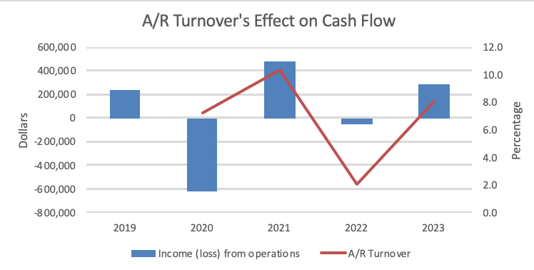
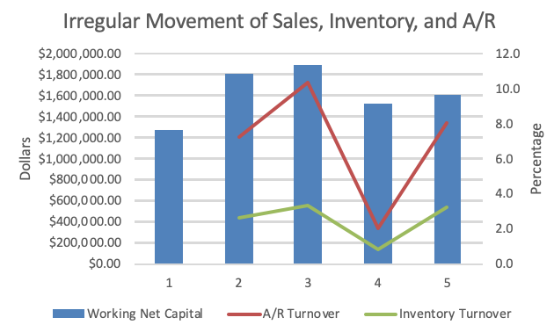
A/r turnover
Notes:
As mentioned before, A/R Turnover flucuated during this 5 year period so we decided to take a deeper dive into it. On the left, we compared the A/R turnover with their operating income. This was to view if A/R is locking up the company's cash.
On the right side, UA's sales, inventory, and A/R. As you can see, sales and inventory turnover are moving consistently but A/R turnover is increasing and decreasing at a faster rate. If all three of these factors are not moving consistently, that is a red flag the company needs to look into and in this case it is A/R.

Slide 11
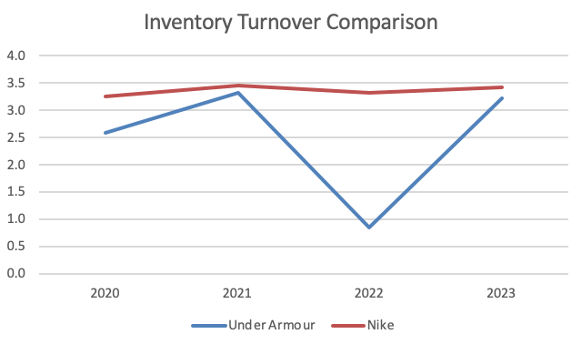
Inventory Turnover
Notes:
Here we have a comparison of inventory turnover between UA and their competitor, Nike. What I find interesting is seeing how the market effected both companies similarly. An increase in 2021, decrease in 2022 and increase in 2023. Unfortunately, you can see a huge difference in the companies ability to sell their merchandise. First, Nike is higher than UA the past 4 years but also, look how consistent nike is compared to UA fluctuations. As mentioned before, this turnover is important for ua to review and unstand what went well during 2021 and 2023. Also figure out how they can improve from 2022. This will lead to inventory build up issues in the future, if not resolved.

Slide 12
FINANCIAL ANALYSIS
Ratios | 2019 | 2020 | 2021 | 2022 | 2023
Gross Margin | 46.9% | 48.3% | 50.3% | 46.5% | 44.9%
Operating Margin | 4.5% | -13.7% | 8.6% | -3.5% | 4.8%
Net Profit Margin | 1.7% | -12.3% | 6.3% | -4.6% | 6.6%
Return on assets (ROA) |  | -11.1% | 7.2% | -1.3% | 8.3%
Return on equity (ROE) |  | -28.7% | 19.1% | -3.1% | 20.8%
Earnings per share (EPS) | $0.20 | -$1.21 | $0.77 | -$0.13 | $0.86
Notes:
Next, we calculated UA's profitability ratios. We found that:
Gross Margin Trends:
The gross margin has experienced a decline from 46.9% in 2019 to 44.9% in 2023. This indicates poor pricing, poor operations efficiency, or both
Operating Margin:
Operating margin showed significant volatility, hitting a low of -13.7% in 2020 and recovering to 4.8% in 2023.
Net Profit Margin:
Net profit margin followed a similar pattern, decreasing into the negative in 2020 and then rebounding to 6.6% in 2023.
Return on Assets (ROA) Performance:
Next is ROA which is considered to be the best ratio to measure profitability. Their ROA was negative in 2020 but showed improvement, reaching 8.3% in 2023. As a rule of thumb, investors like this number at or above 5%
Return on Equity (ROE) Recovery:
ROE experienced a negative dip in 2020 but rebounded to 20.8% in 2023, indicating improved returns for shareholders.
Earnings per Share (EPS) Variability:
Earnings per share (EPS) had a notable drop in 2020, recovering to $0.86 in 2023, suggesting improved profitability per share.
There are some red flags with UA profitability. First a foremost, companies with negative profit margins struggle to survive. UA has had two years in the negative in the past five years.

Slide 13
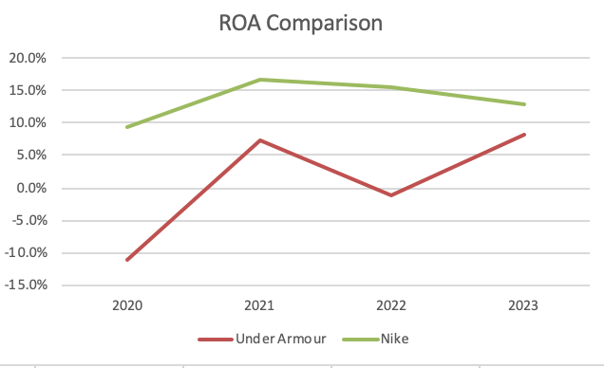
ROA Comparison
Notes:
Now we wanted to understand if UA's competitors were struggling with profitability in the past five years. Especially in 2020. As a reminder, ROA is considered the best ratio to measure company profitability. Unfortunately, that was not the case for Nike. In fact, Nike had just under 10% ROA performance in 2020 and no negative years in the past five years.

Slide 14
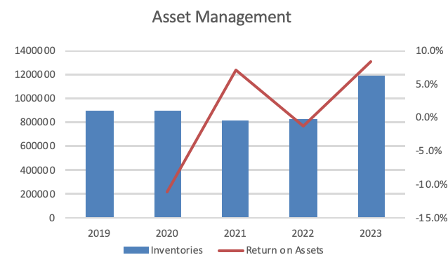
Inventory
Notes:
Because of this finding, we want to understand if UA is losing power in the marketplace or is it lack of control with their inventory and asset management. As you can see on the chart, in 2021, as inventory went down, ROA went up, indicating good use of assets. On the otherhand, the following year, while inventory went up, ROA went down about 8% into the negatives. But this past year not only showed a strong increase an ROA, but an increase in inventory. This is great to see as long as UA manages their inventory properly and avoids build-up.
That being said, after looking at this, it could be argued that their decrease in profit margins could mean they are losing power in their marketplace.

Slide 15
FINANCIAL ANALYSIS
Ratios | 2019 | 2020 | 2021 | 2022 | 2023
Debt Ratio | 56% | 67% | 58% | 61% | 59%
Equity Ratio | 44% | 33% | 42% | 39% | 41%
Debt-To-Equity Ratio | 1.25 | 2.00 | 1.39 | 1.58 | 1.43
Times Interest Earned | (11.1) | 0.3 | (11.9) | (1.7) | (22.1)
Price/Earnings Ratio (P/E) Class A | 103.5 | (7.6) | 29.2 | (136.0) | 11.1
Price/Earnings Ratio (P/E) Class C | 92.4 | (8.8) | 23.9 | (123.1) | 10.0
Dividend Yield | 0.0% | 0.0% | 0.0% | 0.0% | 0.0%
Book Value Per Common Share | 0.04 | 0.06 | 0.05 | 0.06 | 0.06
Notes:
Lastly, we are going to talk about the company's solvency and market prospect ratios. Here are a few key points we want to talk about.
Debt Ratio:
The company's debt ratio has fluctuated and increased over the years, reaching a peak of 67% in 2020 but decreasing to 59% in 2023.
Equity Ratio:
The equity ratio shows an increase from 33% in 2020 to 41% in 2023.
This indicates a positive trend towards a higher proportion of equity in the capital structure, which can be viewed as a sign of financial stability.
Debt-To-Equity Ratio:
The debt-to-equity ratio spiked in 2020, indicating a significant reliance on debt for financing, but it has since decreased to 1.43 in 2023.
This suggests a move towards a more balanced capital structure, which is generally favorable for long-term financial health.
Times Interest Earned:
The times interest earned ratio has been consistently negative, indicating that the company is not generating enough operating income to cover its interest expenses.
This will be concern for investors if the company wishes to rely on equity financing in the future.
Price/Earnings Ratio (P/E):
The P/E ratio for Class A and Class C shares shows significant volatility, with negative values in 2019 and 2020 but positive values in subsequent years.
A negative P/E ratio may indicate losses, while positive values suggest earnings. The company should provide explanations for the negative ratios in 2019 and 2020.
Book Value Per Common Share:
The book value per common share has increased over the years, indicating growth in the shareholders' equity.
This can be positive for investors as it represents the theoretical value of each share if the company were to be liquidated. The company should highlight factors contributing to this increase.

Slide 16
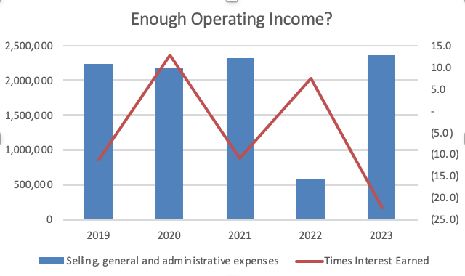
Operating income
Notes:
Because time interested earned was a concerning finding, we took a deeper look into operating expenses. As you can see on the chart, as operating expenses decrease annually, times interest earned increases. And vice versa. Unfortantely, besides 2022, operating expenses were fairly consistant, unlike the volatility of times interest earned which tells us UA is not managing their operating expenses wisely and relying on too much debt financing than they can handle.

Slide 17
Financial summary
Positive Liquidity Trends
Efficient Operations and Inventory Management
Profitability Recovery
Improved Financial Structure
Concerns in Interest Coverage and P/E Ratio
Notes:
There is a lot to take in but here are five points to summarize UA's financial performance
Positive Liquidity Trends:
Working net capital and current ratios show positive trends, indicating the company's ability to cover short-term liabilities with current assets, with a notable rebound in 2023.
Efficient Operations and Inventory Management:
Despite fluctuations, inventory turnover generally improves, reflecting efficient inventory management. The company rebounded from a concerning drop in 2022, demonstrating resilience.
Profitability Recovery:
Despite a decline in gross margin, the company shows resilience in operating and net profit margins, with a notable rebound from negative values in 2020 to positive figures in 2023.
Improved Financial Structure:
The equity ratio increased from 33% to 41% from 2020 to 2023, signaling a positive shift towards a higher proportion of equity in the capital structure. Debt ratios also decreased, indicating a more balanced capital structure.
Concerns in Interest Coverage and P/E Ratio:
The consistently negative times interest earned ratio raises concerns about the company's ability to cover interest expenses. The significant volatility in the P/E ratio, especially with negative values in 2019 and 2020, requires clarification from the company.

Slide 18
Where is UA Going?
Losing power
Debt-financing reliance
Low investor confidence
Stephanie Linnartz
Notes:
So after looking at all of this, where is UA going? First, UA is losing power in the marketplace. With all these apparel companies diluting the martketplace and UA's lack of marketing and presence, they are losing power in the market, as we discussed when comparing them with Nike.
Their consistently negative time interested earned ratio shows there is a large reliance on debt-financing where they cannot cover interest expenses. But this reliance may have to do with low confidence from investors due to the past few struggling years.
But we believe the arrival of Stephanie Linnartz at President and CEO will not only bring positive momentum and new ideas for UA to restore that power, build investor confidence again.

Slide 19
Recommendations
To Creditors
Limit Lending
To Investors
Long-Term Investments
To Under Armour
Invest in marketing
Invest in R&D
Analyze asset management
Analyze operation expenses
Notes:
Here are our recommendations for creditors, investors, and the company.
Starting with creditors, due to the consistently negative time interest earned, creditors should be mindful of lending money to a company that struggles to pay interest expenses with operating income.
On the otherhand, the way UA bounced back in 2023 and with their new CEO, this could be a good long-term investment for an investor who doesn't mind risk. That being said, this is not a company I would invest in if you're looking for a short-term or low risk stock.

Slide 20
Thank you for watching

Slide 21
Reference
Haleem, Abbas. (2023). Under Armour ecommerce grows 6% in fiscal Q4. Digital Commerce 360. https://www.digitalcommerce360.com/2023/05/10/under-armour-ecommerce-grows-6-in-fiscal-q4/
Under Armour. (2023). Annual Report 2023. Under Armour. https://underarmourinc.gcs-web.com/static-files/7c201214-9a4d-461a-b12b-f68b1739e960
Under Armour. (2023). Corporate Governance. Under Armour. https://about.underarmour.com/en/investors/corporate-governance.html
Under Armour. (2023). Our Story. Under Armour. https://about.underarmour.com/en/our-company/history.html
United States Securities and Exchange Commission. (2023). Form DEF 14A for Under Armour INC filed 06/27/2023. Under Armour. https://underarmourinc.gcs-web.com/static-files/dd8fc8df-1c46-455f-96f3-ae38252055a3
Wikipedia. (2023). List of Under Armour Sponsorships. Wikipedia. https://en.wikipedia.org/wiki/List_of_Under_Armour_sponsorships

